Slide 1

Know Thyself

Slide 2


Explain what it means to lead yourself.
Identify and prioritize personal values and beliefs.
Identify specific personal skills, qualities, and attitudes necessary for the leadership journey.
Objectives
Notes:
Pause, get to know each other
5 min

Slide 3
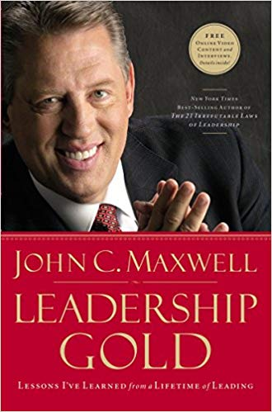
“The toughest person to lead is always yourself.”
—John Maxwell, Leadership Gold
Introduction
Notes:
Read quote: “The toughest person to lead is always yourself.”
—John Maxwell, Leadership Gold
Throughout the Wood Badge course, there will be opportunities to learn more about personal growth and personal planning. These concepts will enhance leadership capabilities and set
each individual up for success in personal, professional, and Scouting life.

Slide 4

Learning Tool
Notes:
The tool representing this session is a mirror. We must first look at our own values to appreciate the values of others.
Self–Leadership and the Identification of Personal Values

Slide 5

Values Discussion
Notes:
How would you define values?
Where do values come from?
What are some examples of value statements?
o Scouting America: Scout Law
o Rotary International: “Service Above Self”
o Boys & Girls Clubs of America:
“Respect, Integrity, Excellence, Teamwork, Innovation”
o Ford Motor Company: “People, Products, Profits”
Can you share an example of someone living their espoused values?
Values are who we are, not who we would like to be or who we think we should be.
They indicate who we are in our lives and how we show up in the world.

Slide 6

Den Exercise
Notes:
Activity 1. Values Card Exercise (15 minutes)
Give each participant a deck of Values Cards and the Values Worksheet.
Ask participants to sort their cards into two to three piles based on their significance to them personally.
Have them choose 10 values that they currently live by.
Ask them to record the 10 on the Values Worksheet and then put the rest in the card box.
Remind them that you are not asking them to give any of the values away but are only asking them to choose for the purposes of the exercise.
Have them look at the 10 cards once more and choose their top five.
Ask them to record the five on the worksheet and put the rest in the card box.
Remind them that you are not asking them to give any of the values away, etc.
Have them look at the five cards and tell them to notice similarities among them.
Ask them to choose their top three values and record them on the worksheet.
Remind them that they can still have all the values, but you are challenging them to pick their top three.
Questions to Ask
● How did you feel about putting the cards back in the box after choosing 10? (Some
may have been upset thinking that you were taking them away.)
● What surprised you about the exercise?
● What did you learn about yourself?

Slide 7

Share Examples
Notes:
Ask den members to share their top three values with the group, and then:
Record these on a flip chart.
Notice any similarities between each of them.
Ask them to post their values in their patrol workspace.
Ask den members to share examples of how their values can be applied to their Scouting
roles.

Slide 8
“This above all: to thine own self be true…”
—William Shakespeare, Hamlet
Share Examples
Notes:
Ask someone to read the quote
Our ability to “walk the walk,” to live out our core values, is a gauge for measuring our ability to lead ourselves. When our actions are aligned with our values, we are in a position to lead
ourselves.

Slide 9
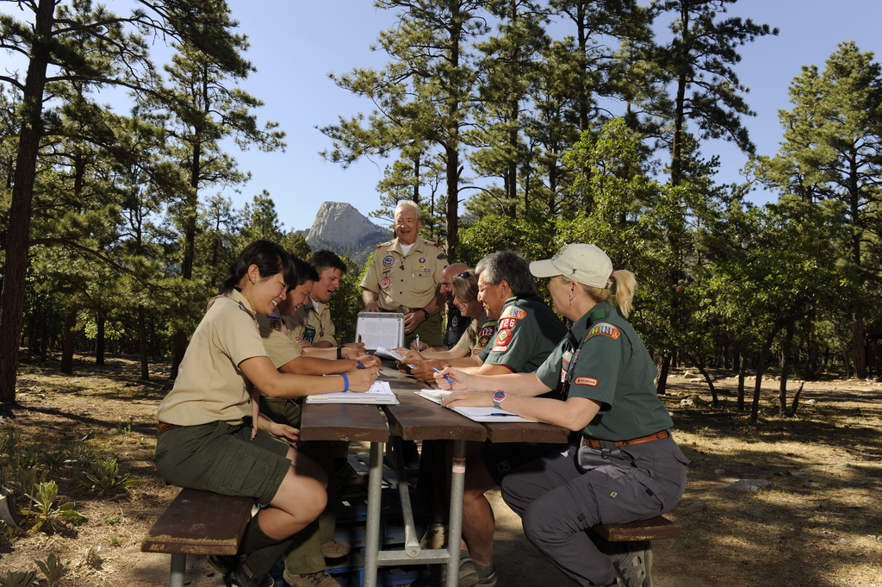
Self Growth
Notes:
“What additional knowledge, attitudes, and skills do you need to lead yourself?”
Den chief should record these ideas on a flip chart and ask the den to post in their workspace for reference through the course.
Den members can also record these thoughts in their participant notebooks as potential Ticket items.
Using the Pre-course Assignment, ask each den member to share their answer to one of these questions:

Slide 10

Self Growth
Notes:
Who were the people who influenced you in your life—either positively or negatively?
What accomplishments are you most proud of, in your life and in Scouting?
Notes for Den Chiefs:
Encourage den members to write their answers and thoughts in their Participant Notebooks for reference throughout the course.
Mention that how they answered the questions on the Pre-course Assignment and their contributions to the group discussion may point to clues of their personal leadership purpose.
Ideas to bring up include the following:
What have been the consistent themes, threads, passions, talents, and skills you have noticed about yourself?
What have people told you that you are good at?
When you were 10 years old, what did you tell everyone that you wanted to be?
Are you doing anything similar today?

Slide 11
Summary
Notes:
The metaphor of the mirror reminds us that we cannot lead others until we work on leading ourselves. This requires looking inward and developing from the inside out
by aligning personal values, communication style, and behavioral style.
For you to lead yourself, it is important to develop from the inside out.
Discuss: “What does ‘from the inside out’ mean to you?”
Post-Session Reflection:
What personal leadership skills are “growth opportunities” for you?
Ask den members to share one skill each.
Remind members to record their ideas in their notebooks as potential Ticket items.

